Slide 1
Managing Secrets

Slide 2
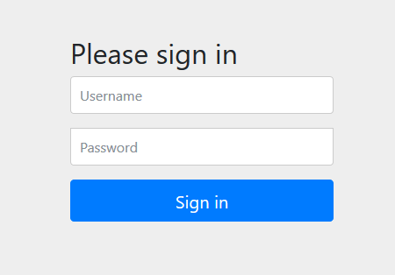






Application Secrets
Application
user:password
Database

Slide 3

Overview
Encrypt your secrets within the application.
Externalize your secrets with Spring Cloud Vault.
Best practices.

Slide 4
Encrypting Secrets in Your Application

Slide 5
There is more to secret management then just encryption.

Slide 6
Secret Sprawl

Slide 7


Secret Management
Rotated Frequently
Auditing
By Who? When? And Why? A secret was accessed.

Slide 8






Secret Sprawl

Slide 9
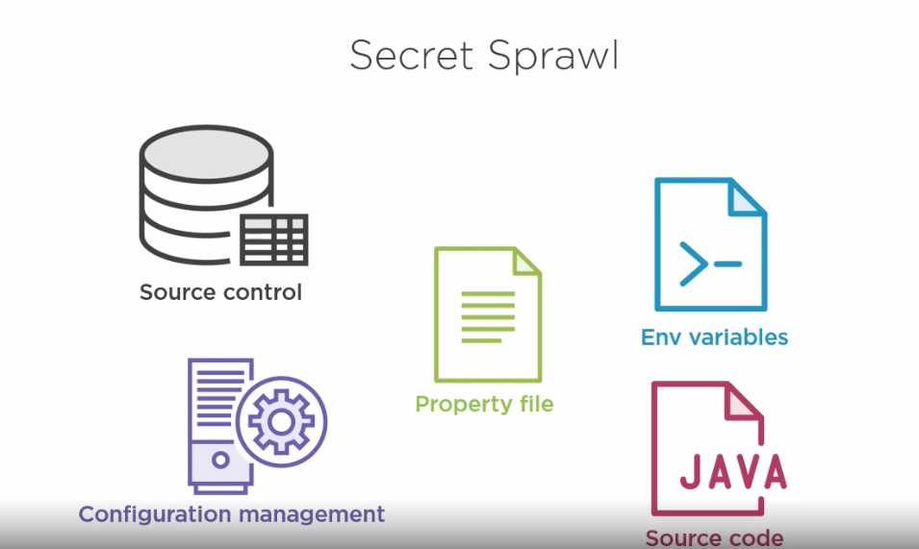

Slide 10
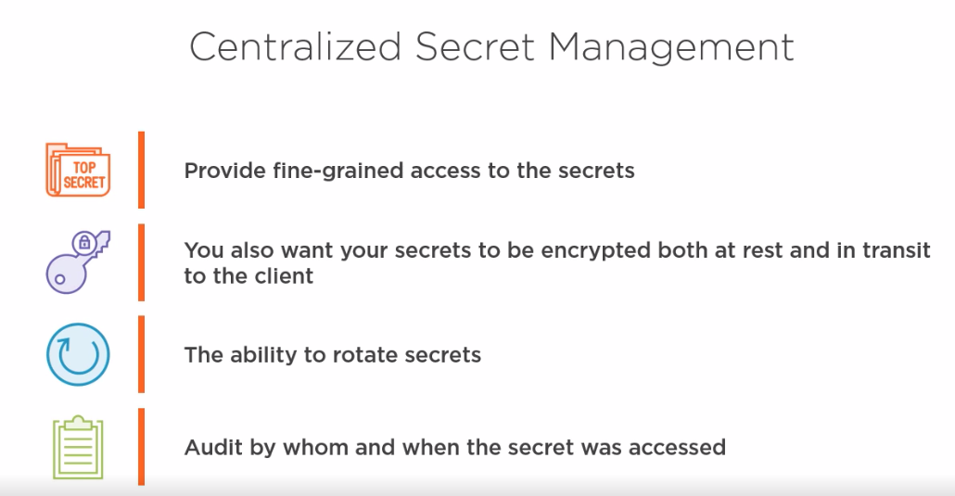

Slide 11
Don't leave un-encrypted secrets in your source code or properties files.
Wrap up
Secret management is more then encryption, its rotation, auditing.
Consider a centralized secret management solution like Spring Cloud Vault.

Slide 12



Slide 13



Secret Management
Secrets can get leaked into source control.
Secret rotation becomes challenging and risky.
Secrets become stale, applications stop using them but they remain active.

Slide 14
